Slide 1
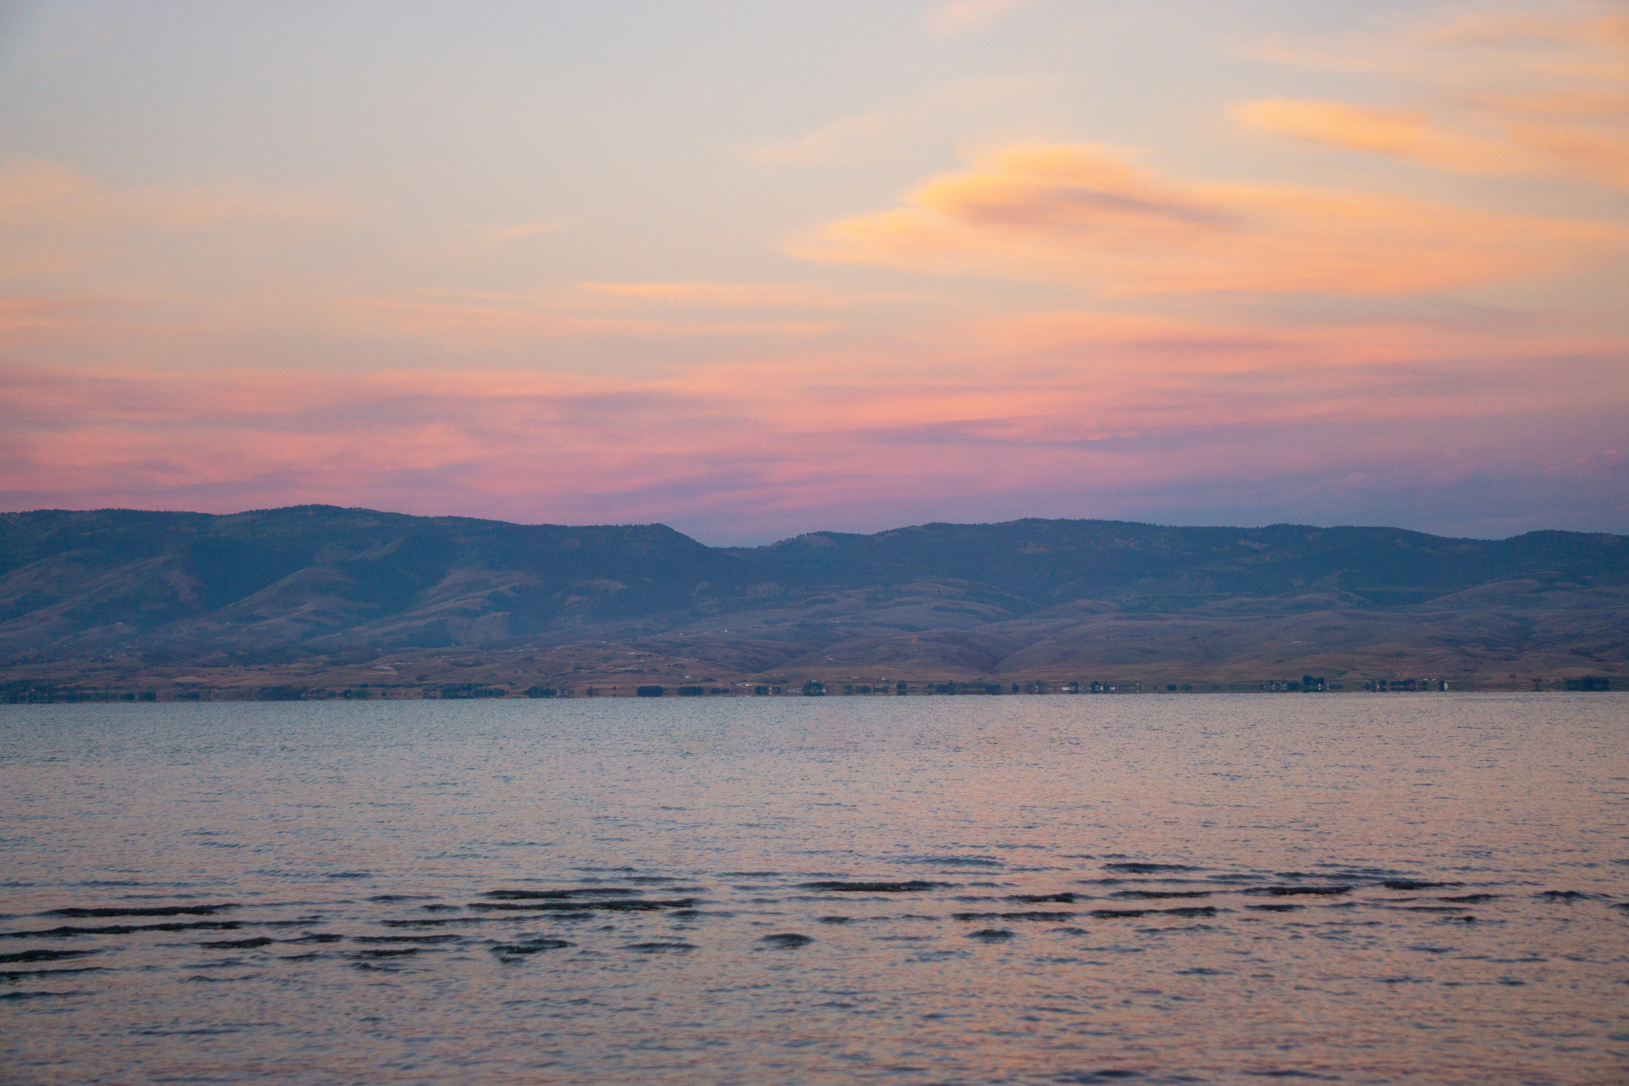

Data Visualization Challenge
Nathan Guymon

Slide 2
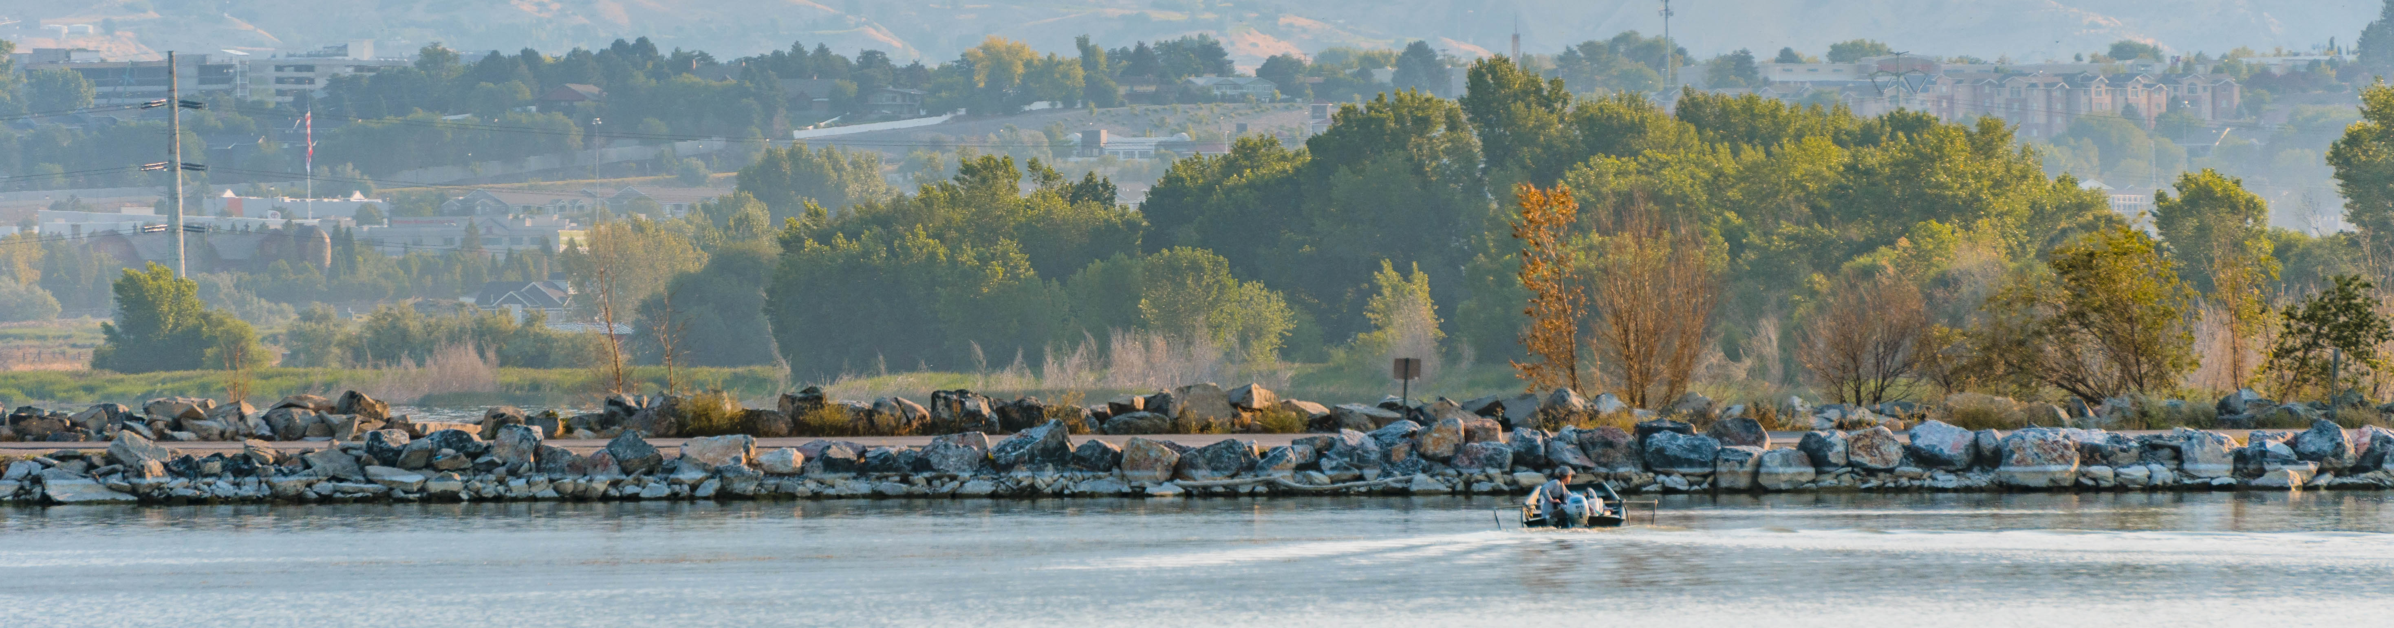
Goals
01
02
03
04
Informative
Accurate
Understandable
Appealing
Code is flexible and well structured
Correct data is conveyed by each graphic
Graphics are easily understood
Visualizations have a similar design

Slide 3
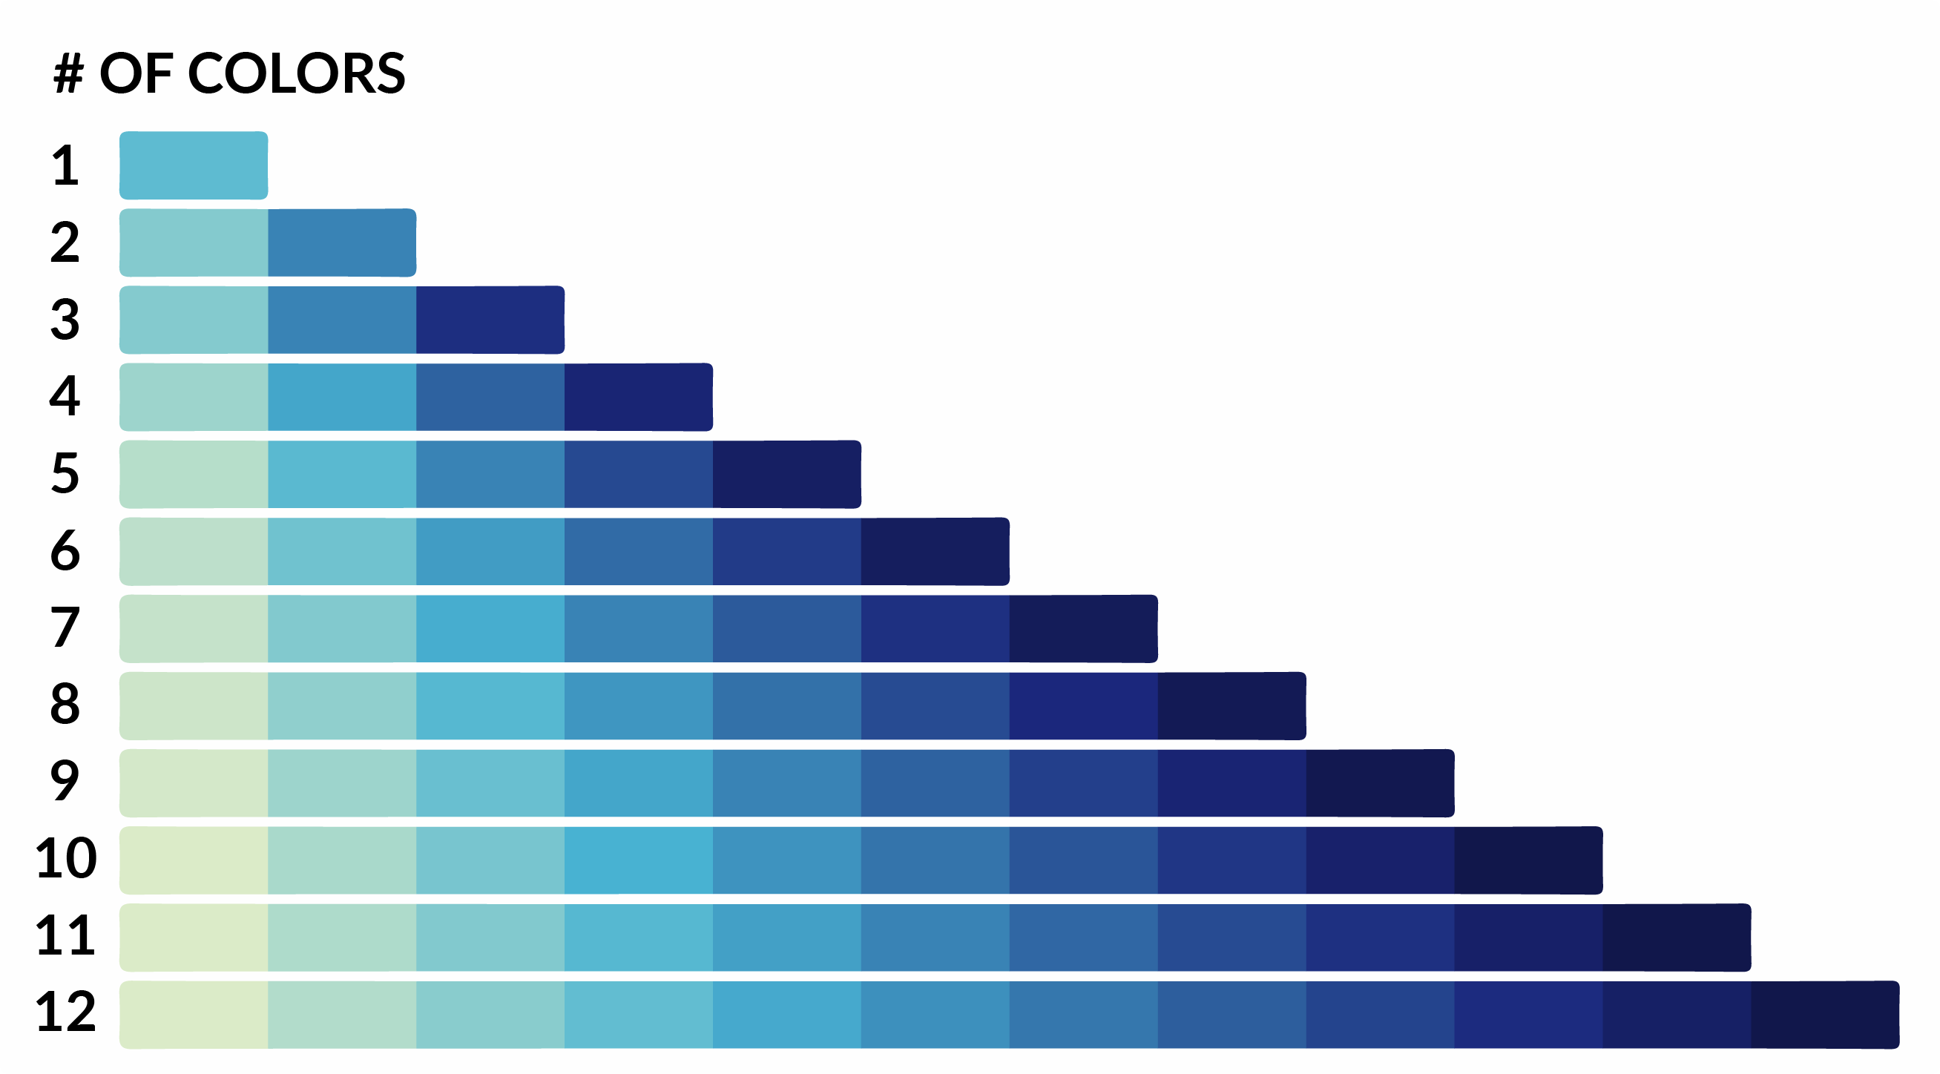
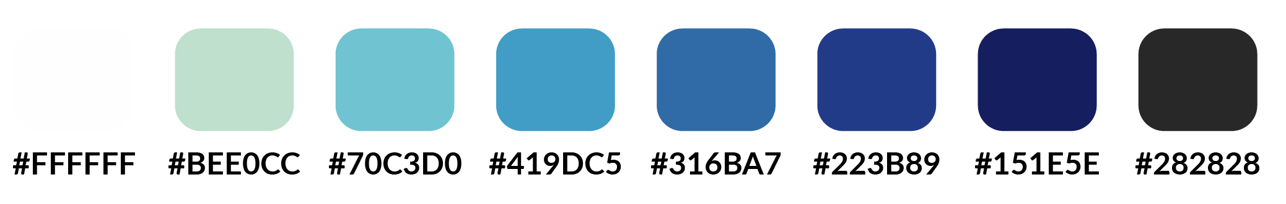
About the Project
The project was built using:
Python 3
Jupyter Notebook
Pandas
Matplotlib
Seaborn
Plotly
Pillow
The visualizations are designed for:
Printed reports
Webpages
Email templates
Etc.
The main fonts in the project are [1]:
Lato (headings/titles)
Merriweather (body)
A color palette was selected to maximize visibility:
Range of hue and brightness [2]
Report palette
Notes:
Done in Anaconda Distribution with Python 3.8.4

Slide 4
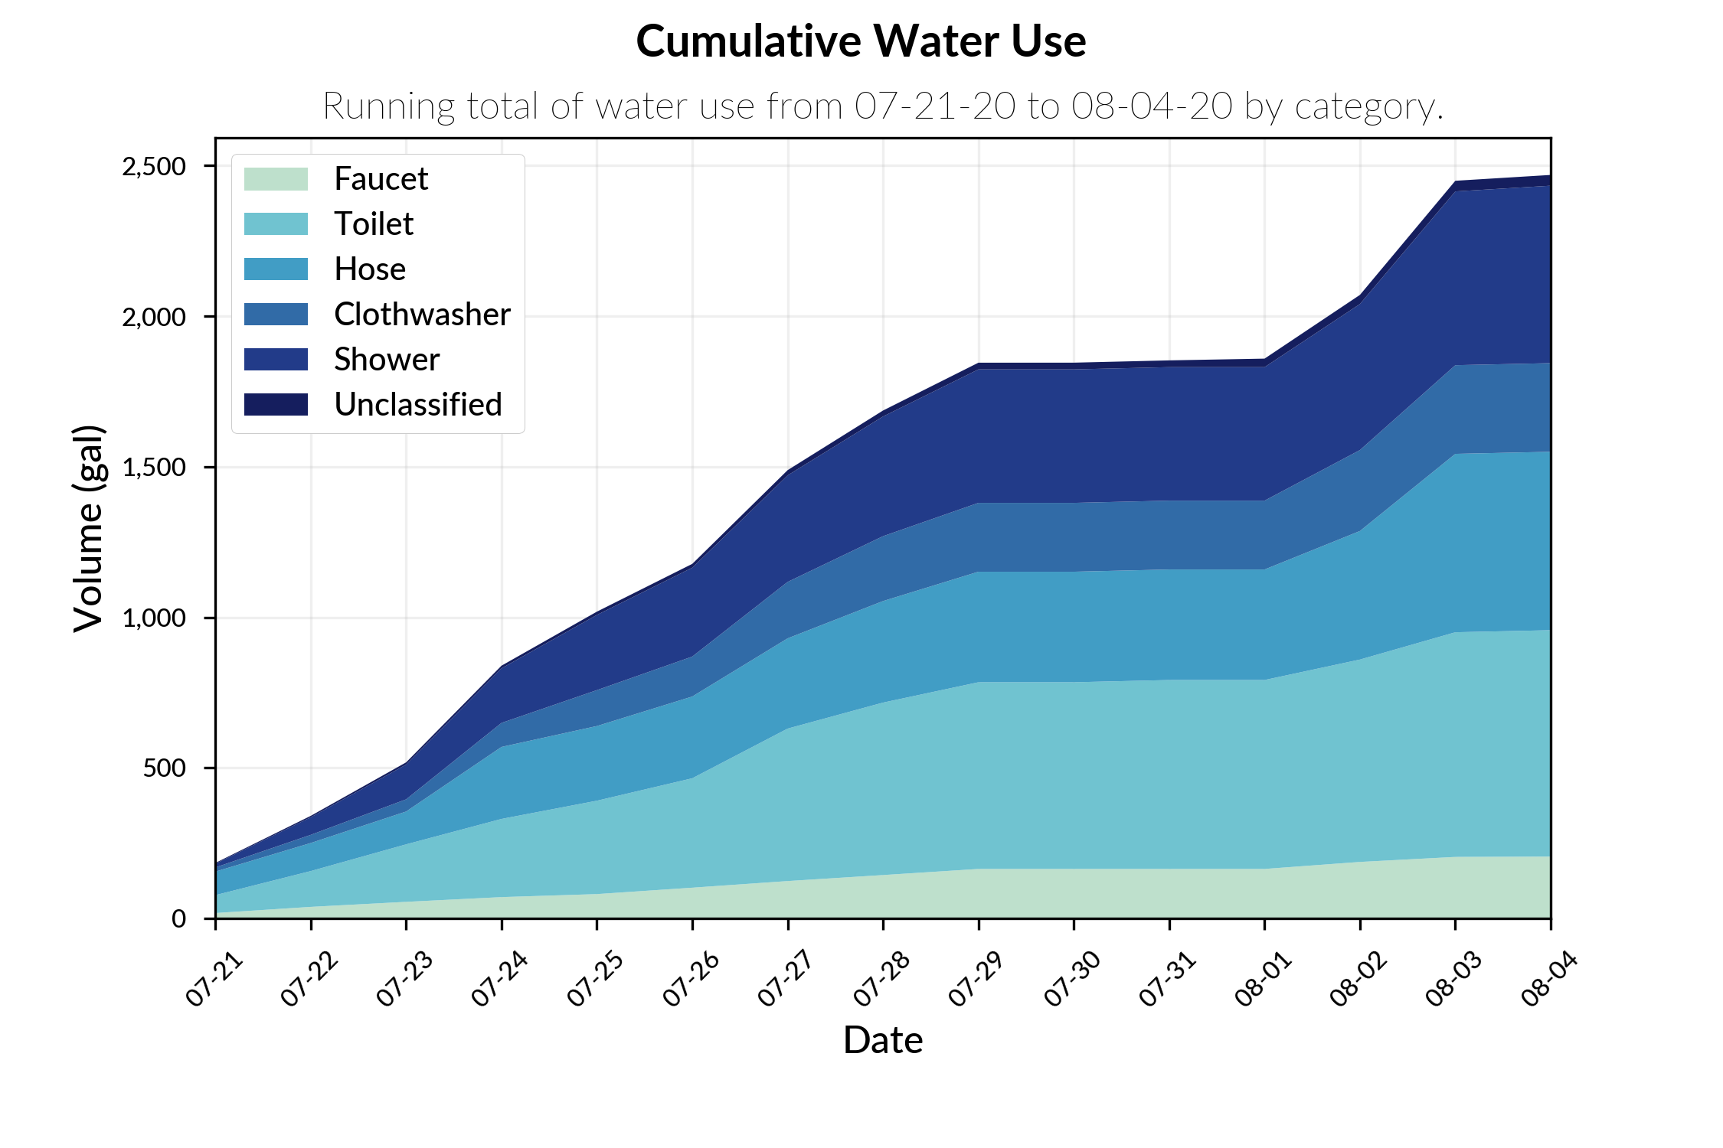
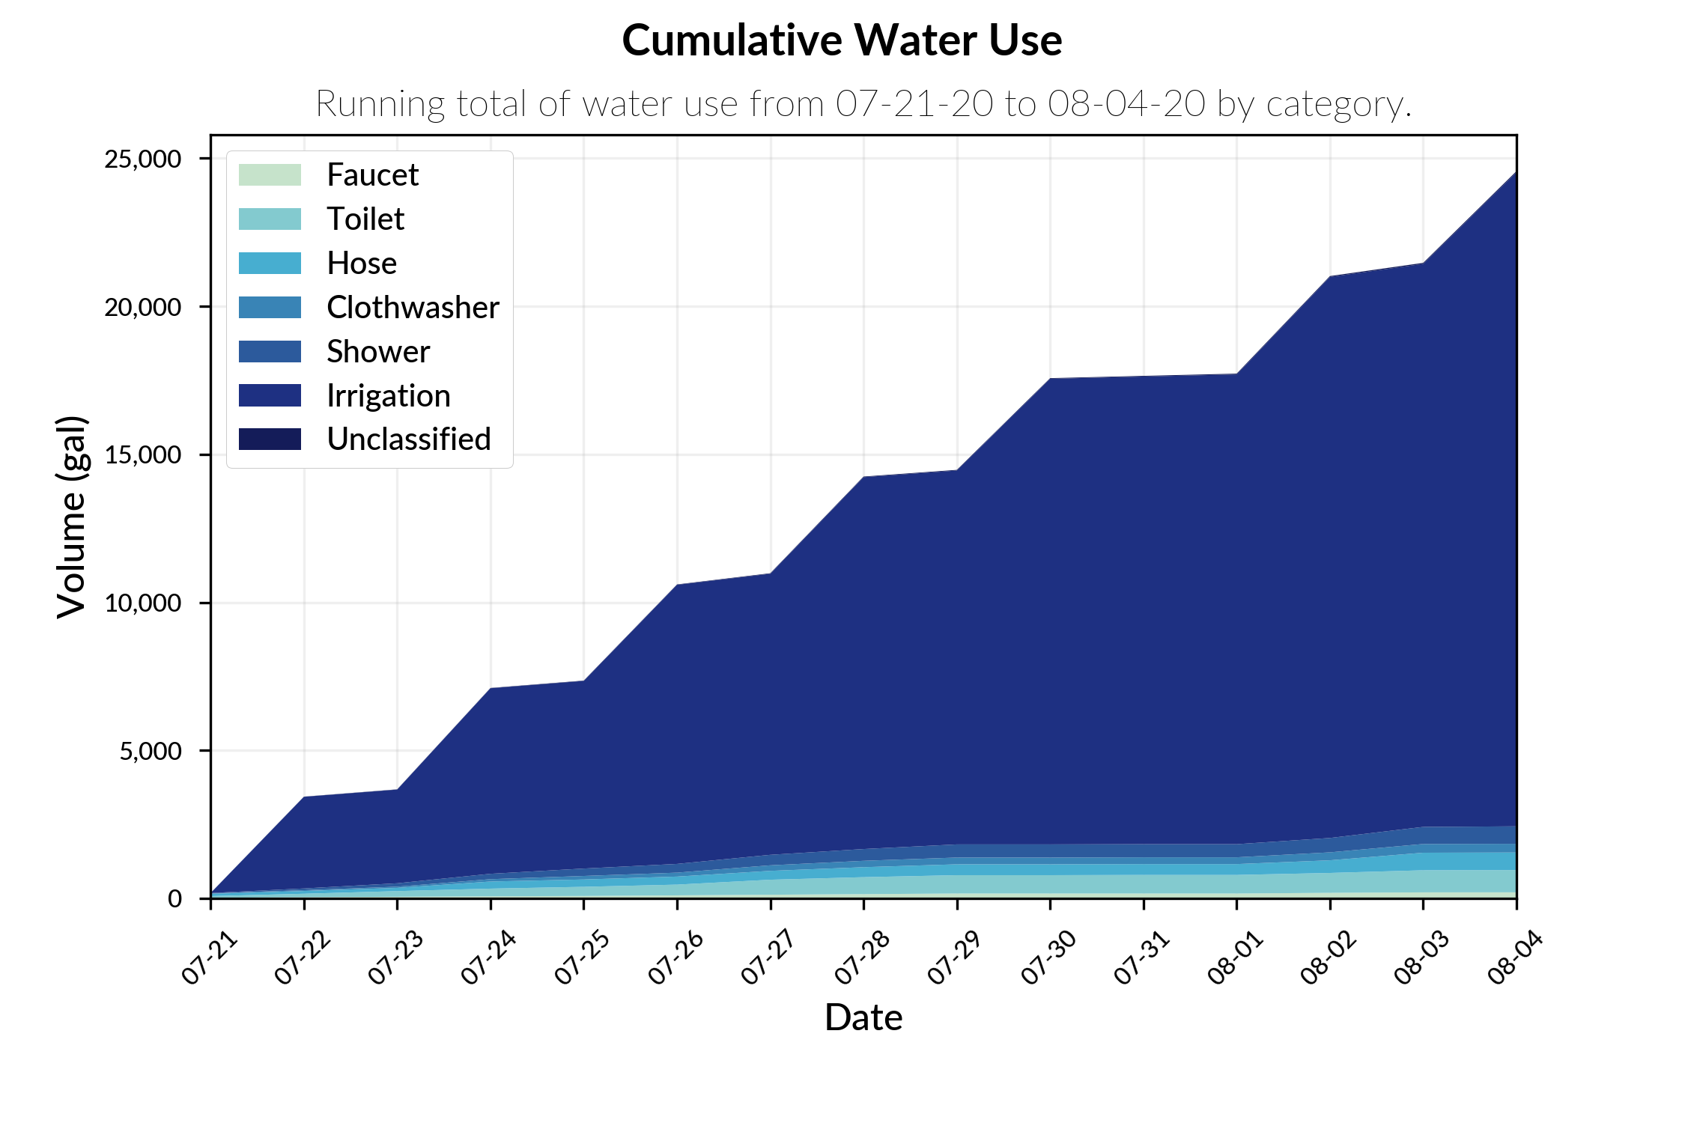
Stacked Area Plot
Compares the relative breakdown of water usage between categories over time.
Notes:
Calculates cumulative sum over different time periods (year, month, week, and day).
Can easily change date range, label selection, cumsum period, figsize, and figtype to save as.

Slide 5
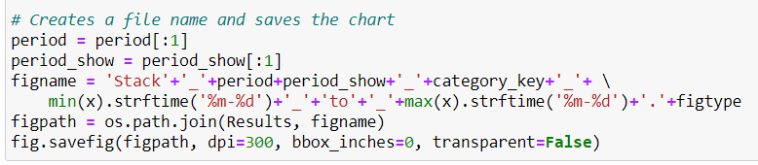
Dynamic Filenames
Example from code:
Filename:
Stack_YC_No_Irrigation_07-21_to_08-04.png
Chart Type
Period
Labels
Date Range
File Type
Notes:
File name also changes dynamically for each chart.

Slide 6
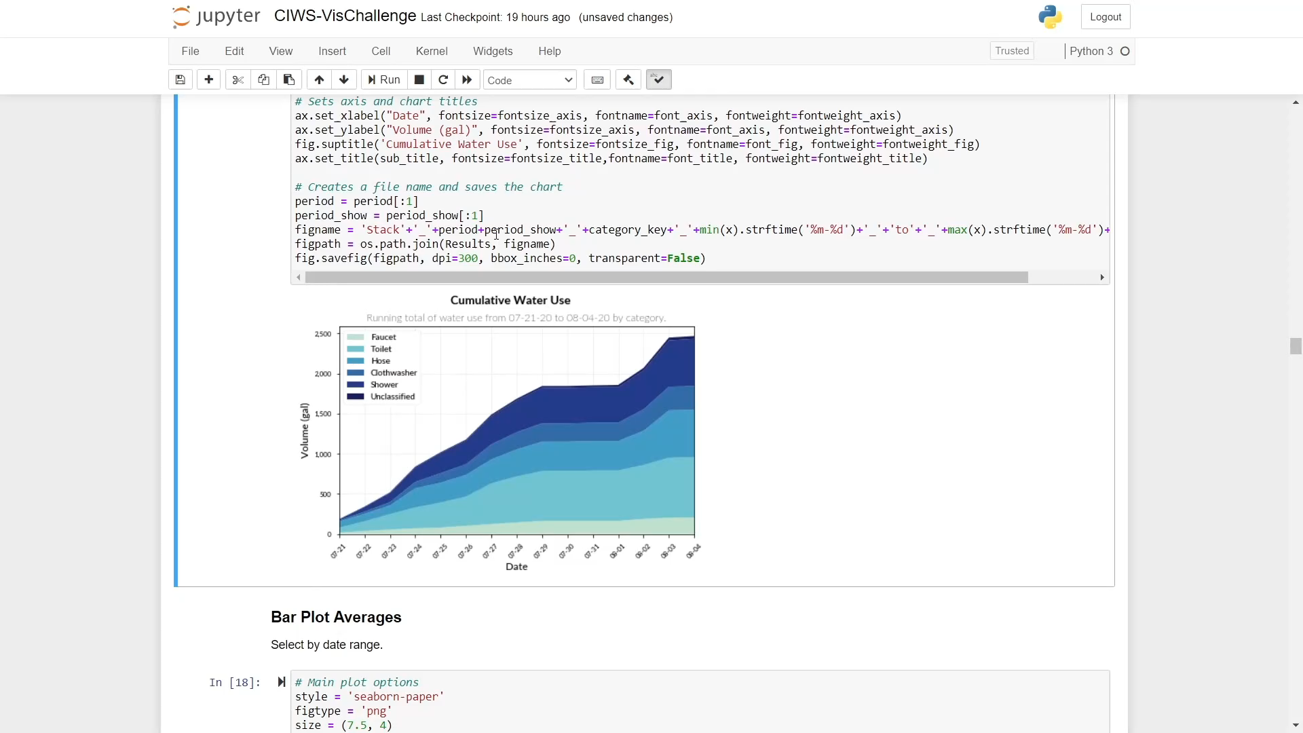
Code Example – Stacked Area Plot
Notes:
All charts share a similar amount of flexibility depending on plot type

Slide 7
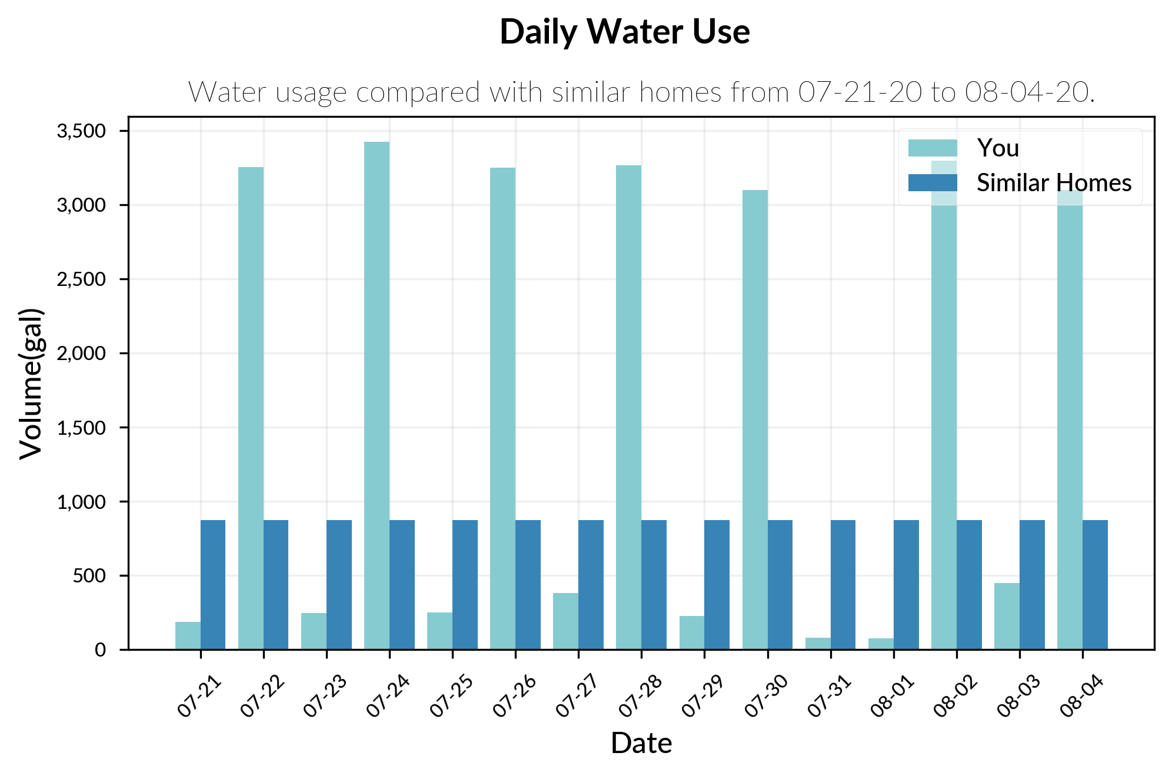
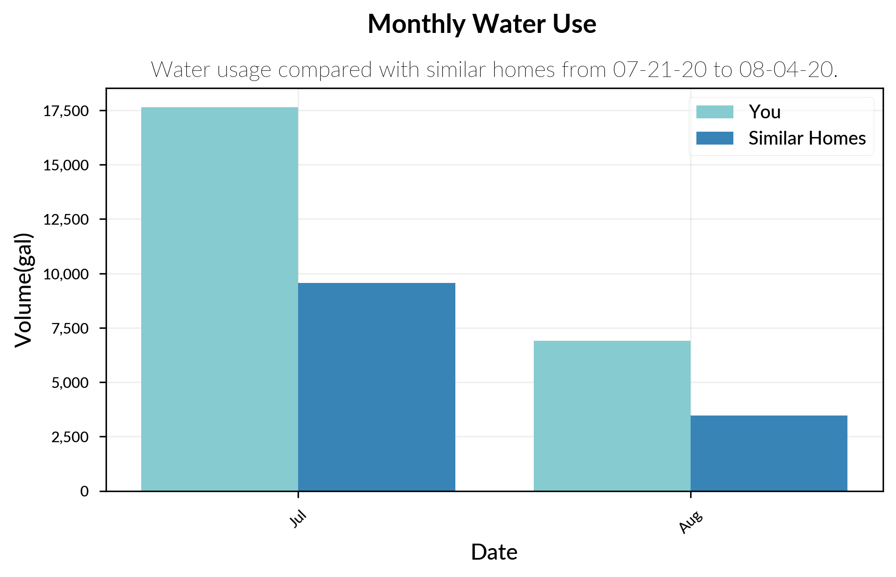
Bar Plot Comparison
Compares the homeowner's water usage to the average in the area. Averages are based on data from the Utah Division of Water Resources [3].
Notes:
Calculates water use over different time periods (year, month, week, and day). Notice how title changes.
Can easily change date range, label selection, cumsum period, figsize, and figtype to save as.
Done because research shows comparison is best
174 gallons

Slide 8
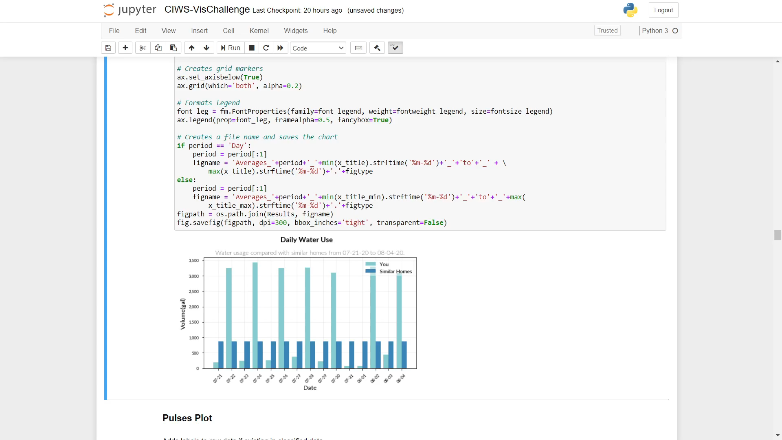
Notes:
Changes date sums and date range

Slide 9
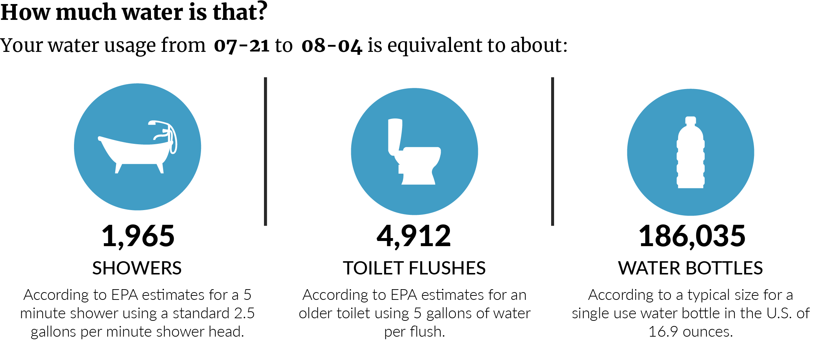
Infographic
This infographic helps to visualize water usage compared to household items that a typical homeowner uses on a regular basis. Water use for each household item is estimated according to the U.S. Environmental Protection Agency [4,5].
Notes:
Can show any date range

Slide 10
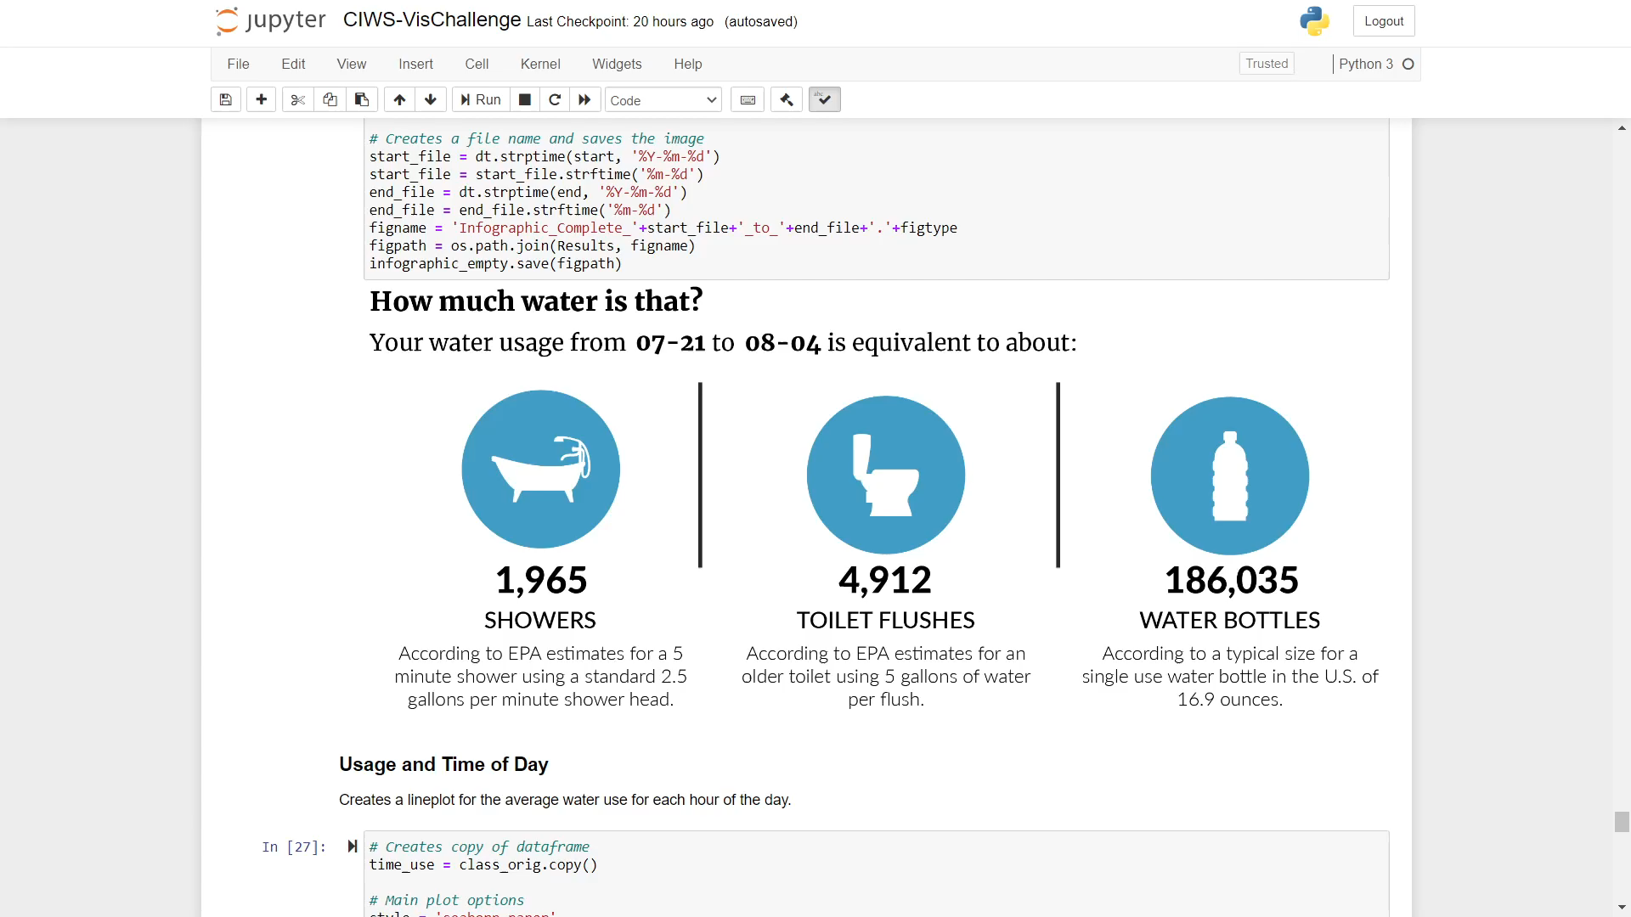
Notes:
Built on a static png image that is then updated using the Pillow library to write on images

Slide 11
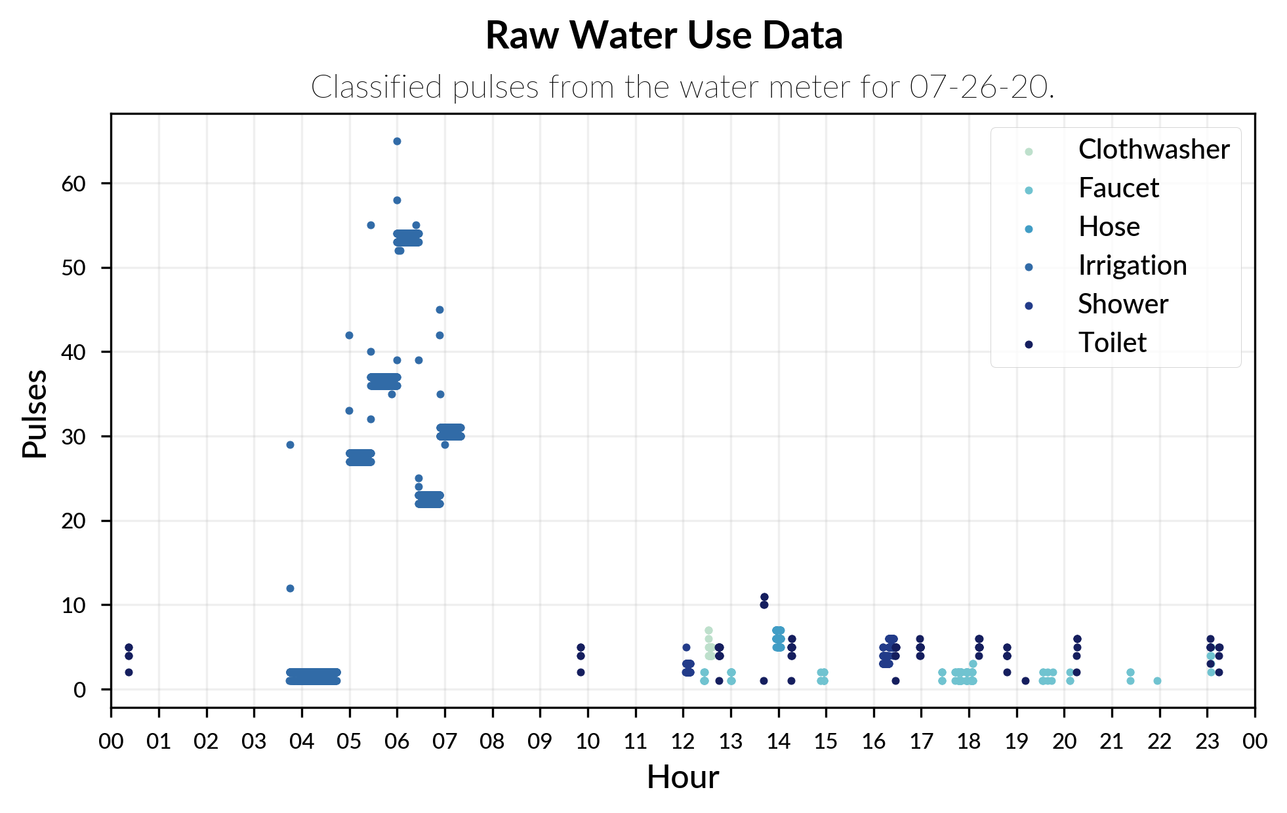
Raw Pulses Classification
This plot is used to demonstrate the classification of the raw data over the course of a day.
Notes:
Example of how data is classified
Ignores values of 0 and unclassified data

Slide 12
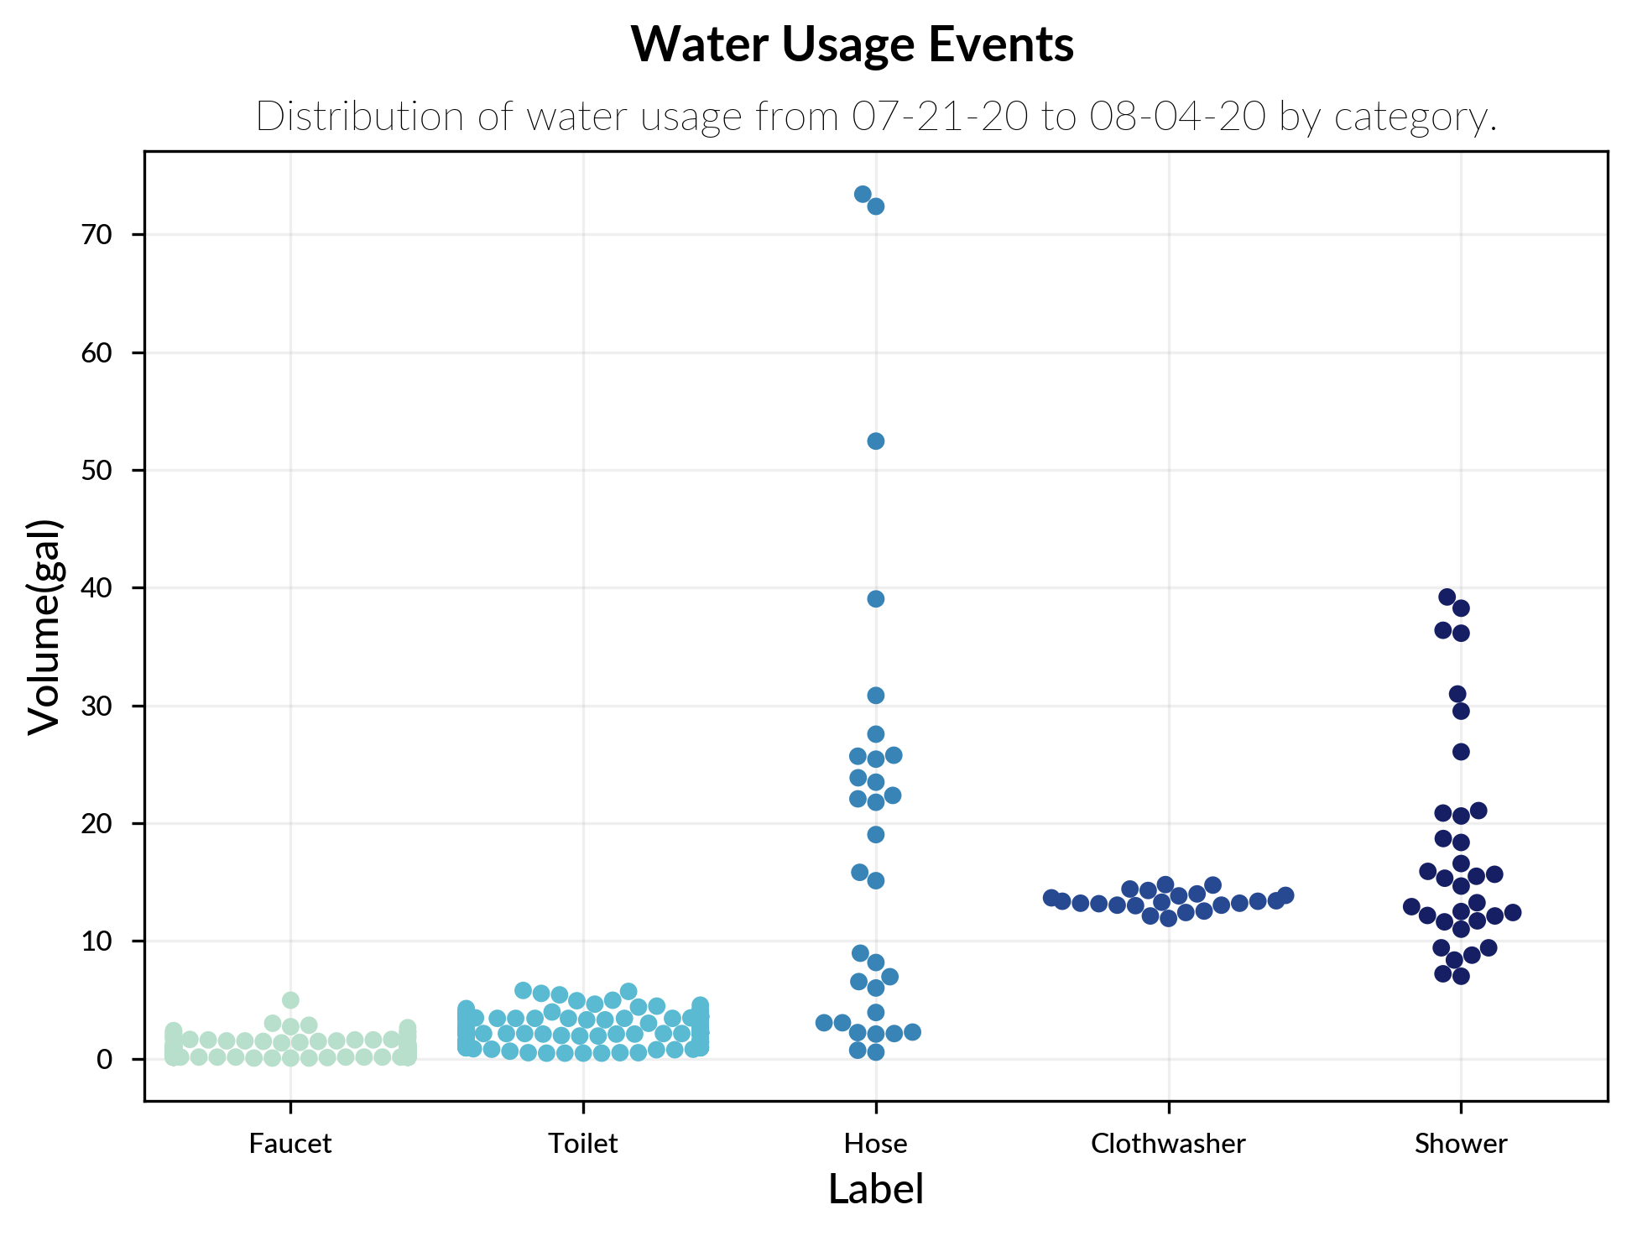
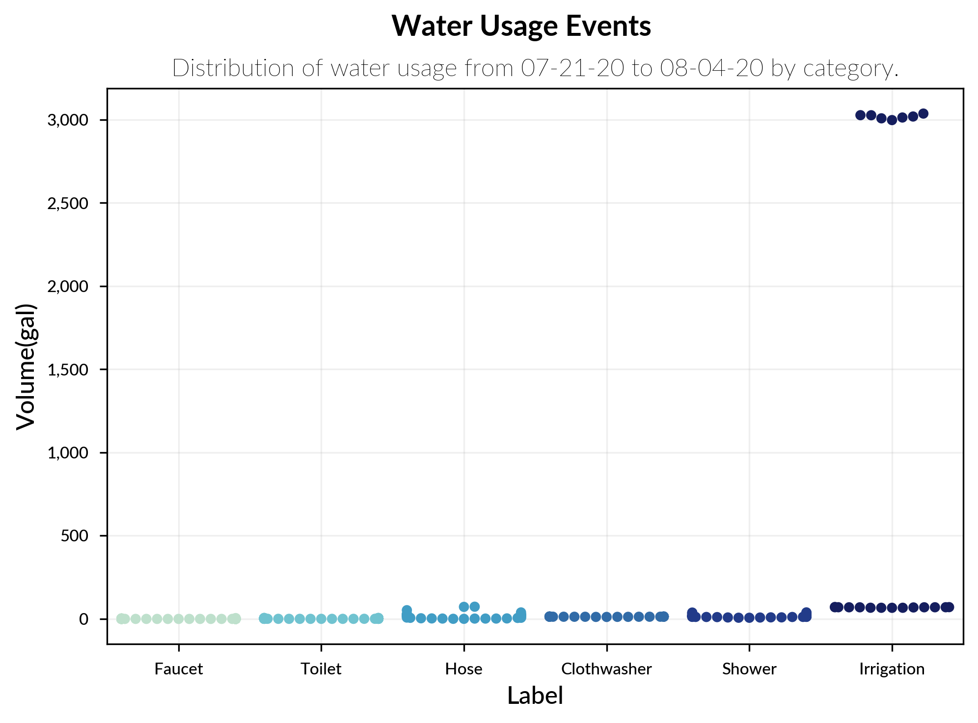
Swarm Plot Distribution
Used to visualize the distribution in size of usage events over a specified time period.
Notes:
Choose categories and date range

Slide 13
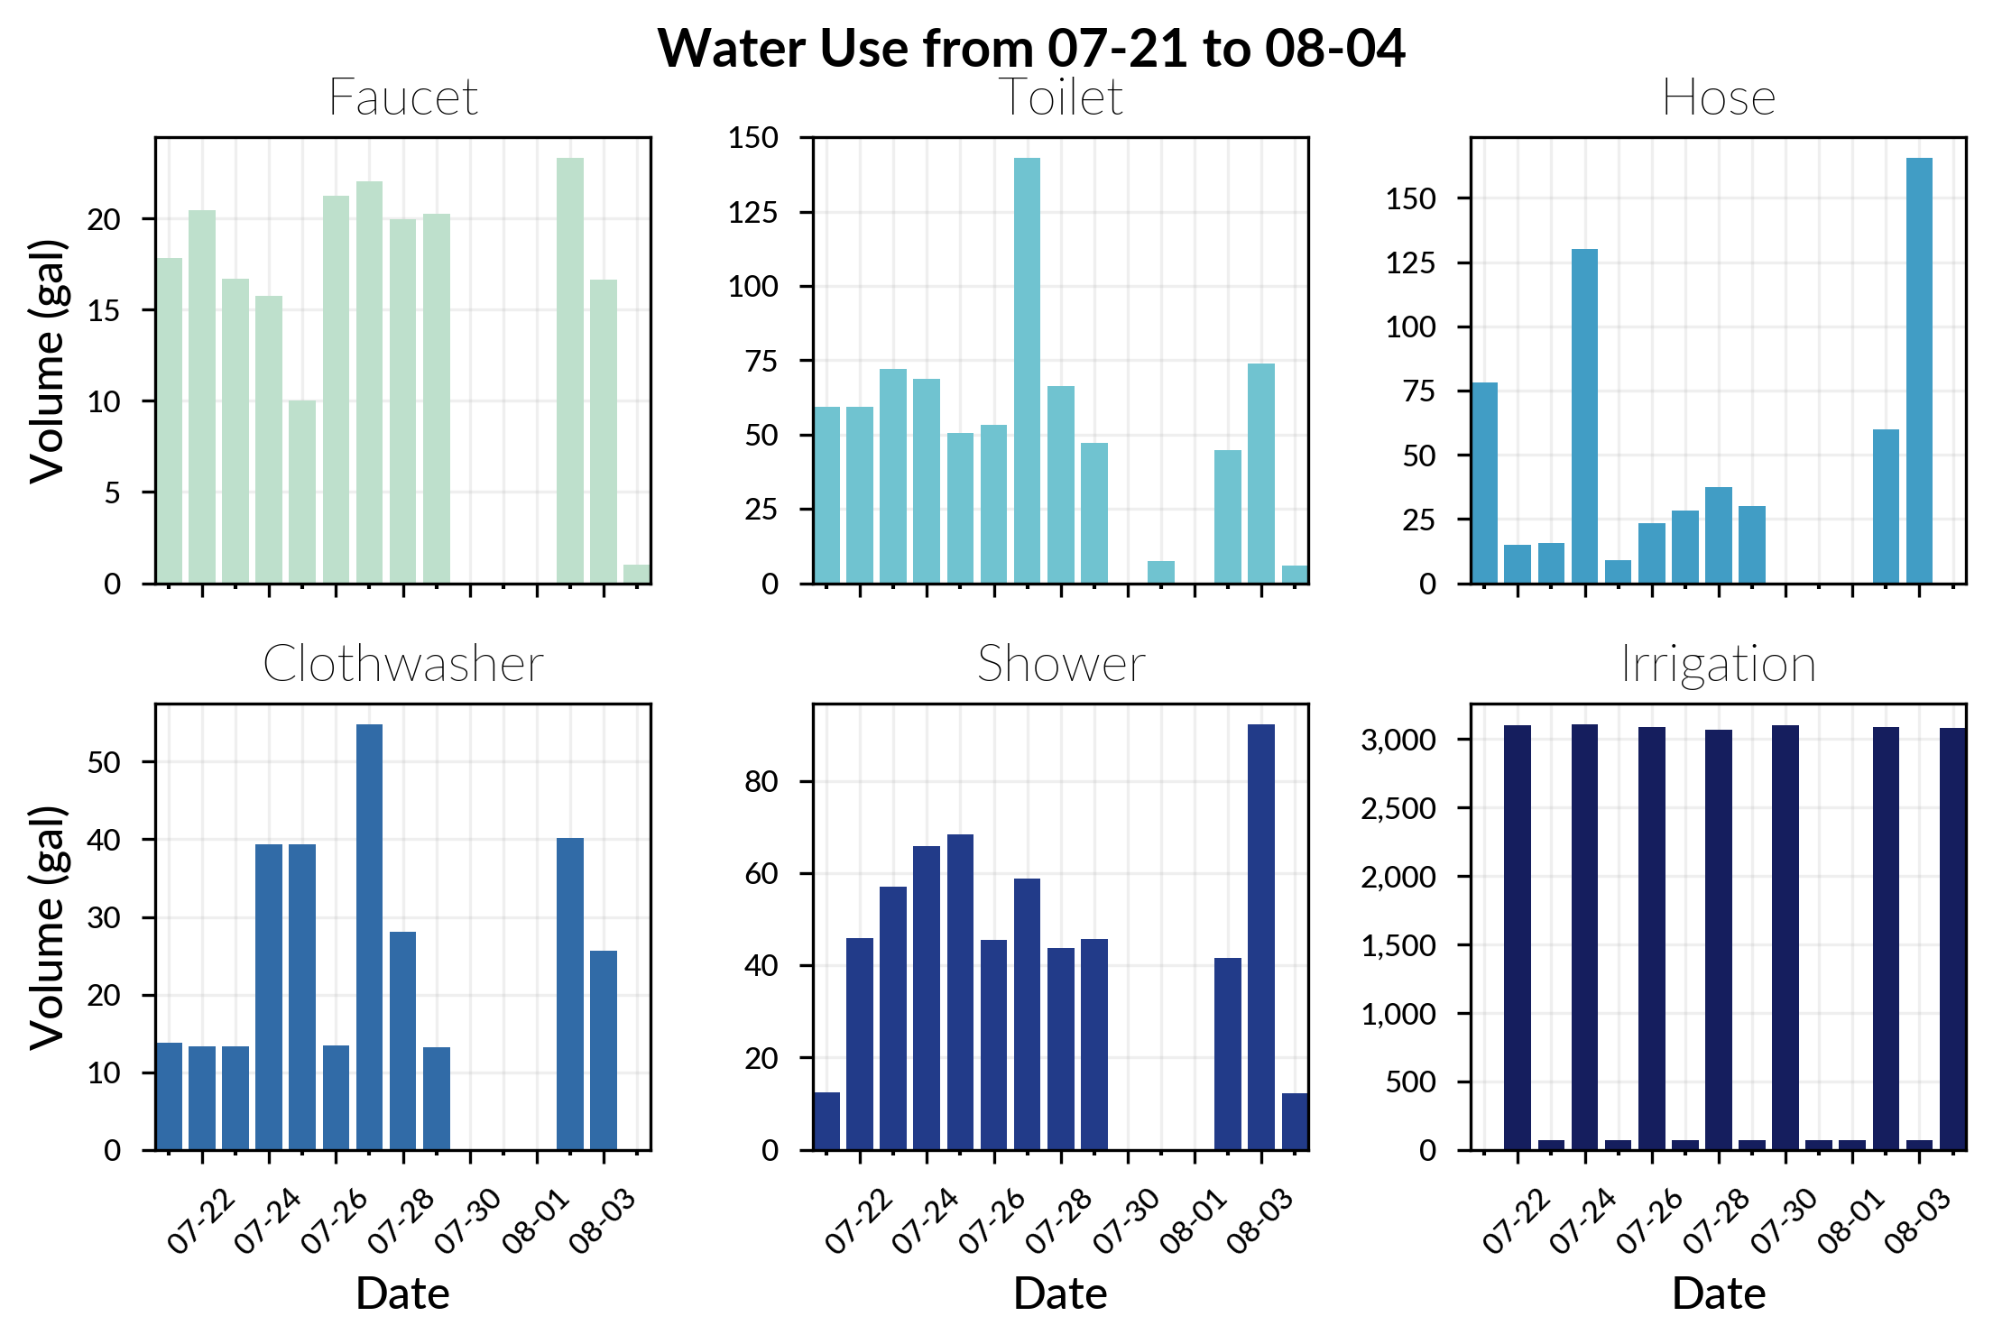
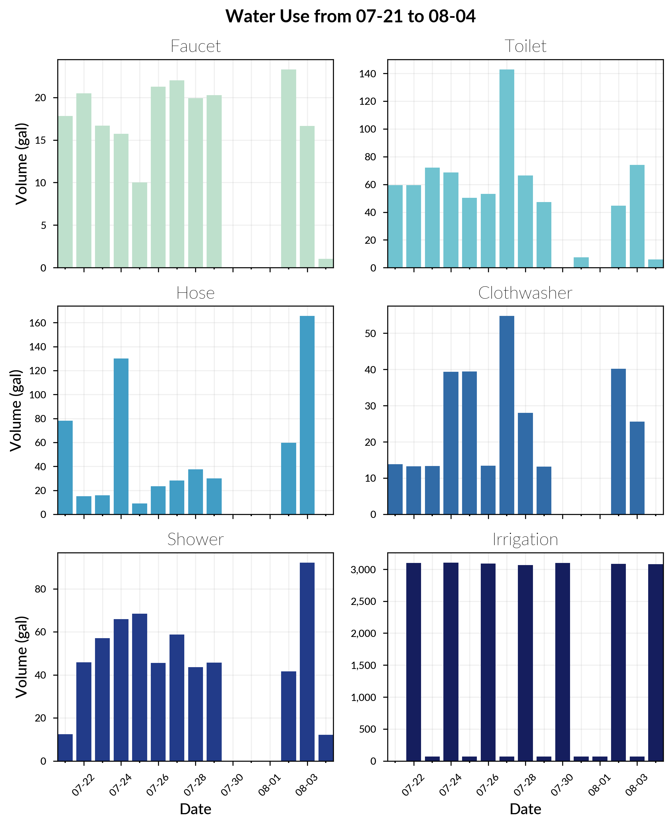
Side by Side Bar Plots
Used to visualize the distribution of usage by category side by side.
Can display horizontally or vertically.
Notes:
Can change to be vertical or horizontal.
This eliminates the need to remove irrigation data as in many of the previous plots.

Slide 14
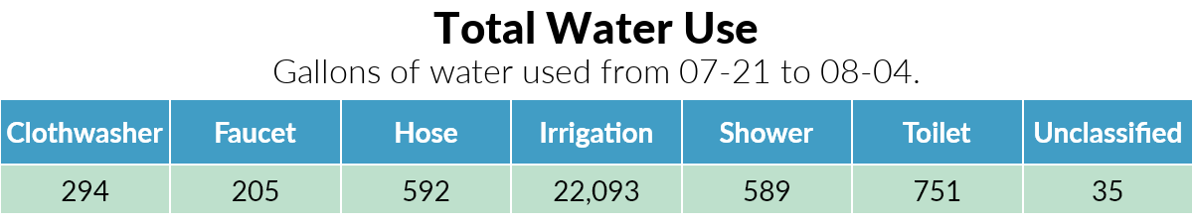
Total Use Table
Shows quantitative usage by category for a specified period.
Notes:
Good look at totals
Creates table image with Plotly then edits with Pillow

Slide 15
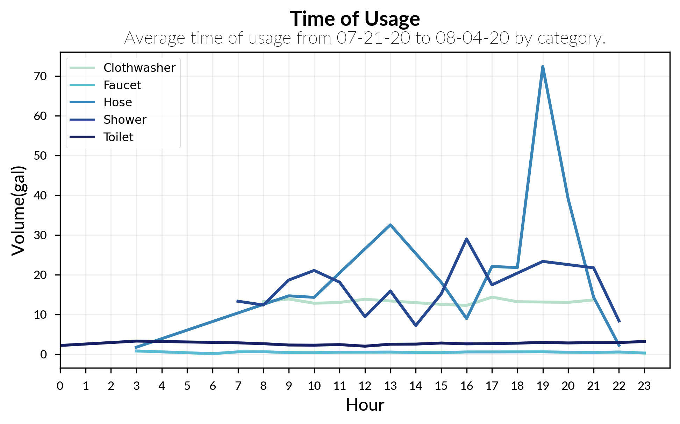
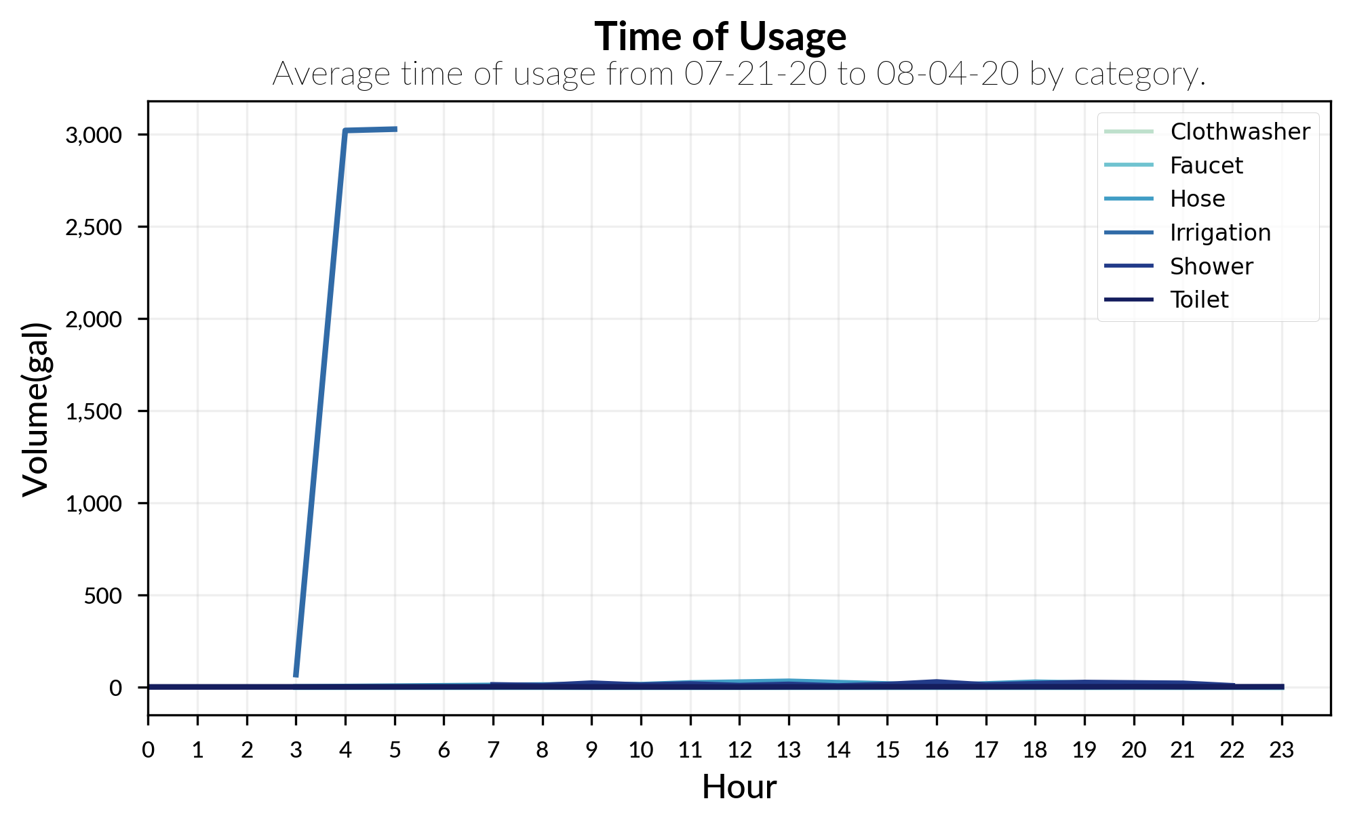
Hourly Average
Visualizes the average use of the time period for each hour of the day.
Notes:
Show patterns of usage for hours of the day

Slide 16
References
[1] https://medium.com/nightingale/choosing-a-font-for-your-data-visualization-2ed37afea637
[2] https://blog.graphiq.com/data-visualization-color-palettes-37fbc8fc0032
[3] https://water.utah.gov/wp-content/uploads/2020/07/2015WaterDataV3.pdf
[4] https://www.epa.gov/sites/production/files/2017-03/documents/ws-facthseet-indoor-water-use-in-the-us.pdf
[5] https://www.epa.gov/watersense/showerheads

Slide 17




Thank You
Nathan Guymon
Nathan.Guymon@aggiemail.usu.edu
https://github.com/nguymon/CIWS-VisChallenge

